Slide 1
FlipTab from Team Norse
OEP

Slide 2
Summary
What is FlipTab?
Value Proposition
Sales & Marketing Strategy
Marketing
Partnerships
Distribution
Costs
Revenue Model
Funding
Team Norse

Slide 3
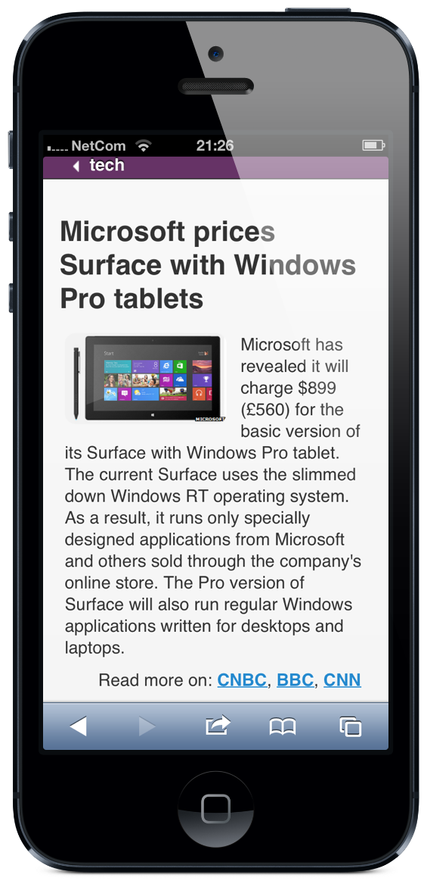
What is FlipTab?
Personal mobile news service
3 dimensions of intelligence:
Summarized Stories
Relevant Adverts
Optimized Ad Layout for Each User
No -ive impact on the user's experience
FlipTab Mock-Up:
http://fliptab.org/
Best viewed using a Smartphone

Slide 4
Value Proposition
Value Proposition for FlipTab Users
Reduce time to relevant news ‘on the move’
Value Proposition for Advertisers
Maximize marketing spend by Increasing CTR
By using data driven web design we can personalize the layout served to any individual user. The layout will increase the chances the user will click on the advert thereby increasing the click through rate (CTR)

Slide 5
Sales & Marketing Strategy
For FlipTab – the news service
Online demand generation
Offline demand generation
For FlipTab – the advertising platform
Proof of concept through FlipTab news service
Optimize the ad serving platform by:
Running experiments on FlipTab users.
Once technology mature AND proven Value Proposition
We then have a reference customer allowing us to
Use B2B marketing techniques to sell platform:
Direct to Advertisers
Indirect to Advertisers via Agencies
(which will allow us to quickly scale)

Slide 6
Marketing
Market Segmentation
Market Size – We are targeting global demographic:
Read news every day (language not important)
Digitally active
Are any age
Gender agnostic
Numbers in the hundreds of millions
Market Wealth – Does this market have the money to spend on your product?
Our target group will be A+,A,B,C social groups
Go-To-Market
Online Marketing Methods:
Direct
E-mail Marketing
Social Media Marketing
Viral marketing
SEO (Search Engine Optimisation)
Off-line Marketing Methods:
Journalists and community leaders are great influencers as well.
Engagement with journalists prior to reaching out is key

Slide 7
Sales
Acquisition (per week)
Impressions (Natural Search, E-mail Social, Direct) | 4,000K
2% CTR (but 100% for Direct)
Clicks per week | 1,085K
Advertising
2% CLICK RATE
Clicks per quarter | 282K
Cost per Click = £1.50
Ad Revenue per Quarter | £424K

Slide 8
Partnerships
Partner with leading universities for expertise in Machine Learning and Big Data
Mobile ad platforms e.g. iAD & MobAd
Advertising Standard Bodies such as the iab

Slide 9
Distribution
B2C
App marketplaces such as:
iTunes App Store
Google Apps marketplace
Bundling FlipTab with mobile manufacturers
Samsung
HTC
Nokia
RIM
B2B
Advertisers: Direct
Once established can go Indirect via Agencies

Slide 10
Costs
Time Period | Q1 | Q2 | Q3 | Q4 | Q1 | Q2 | Q3 | Q4 |  | Y1 | Y2
Cost of Sales
Acquisition costs
Direct | - | - | - | - | - | - | - | - |  | - | -
Paid Search | - | - | - | - | - | - | - | - |  | - | -
Natural Search | 150 | 150 | 150 | 150 | 150 | 150 | 150 | 150 |  | 600 | 600
E-mails | 500 | 500 | 500 | 500 | 500 | 500 | 500 | 500 |  | 2,000 | 2,000
Social Networks | - | - | - | - | - | - | - | - |  | - | -
Acquisition: Cost per Quarter | 650 | 650 | 650 | 650 | 650 | 650 | 650 | 650 |  | 2,600 | 2,600
Operating Costs
Sales and Marketing | 2,000 | 2,000 | 2,000 | 2,000 | 2,000 | 2,000 | 2,000 | 2,000 |  | 8,000 | 8,000
Travel and entertainment | 1,000 | 1,000 | 1,000 | 1,000 | 1,000 | 1,000 | 1,000 | 1,000 |  | 4,000 | 4,000
CMS | - | - | - | - | - | - | - | - |  | - | -
Analytics | - | - | - | - | - | - | - | - |  | - | -
Hosting | 1,500 | 1,500 | 1,500 | 1,500 | 1,500 | 1,500 | 1,500 | 1,500 |  | 6,000 | 6,000
Depreciation | 3,000 | 3,000 | 3,000 | 3,000 | 3,000 | 3,000 | 3,000 | 3,000 |  | 12,000 | 12,000
Web Design | 10,000 | 10,000 | 10,000 | 10,000 | 10,000 | 10,000 | 10,000 | 10,000 |  | 70,000 | 40,000
Development & Support Team | 30,000 | 30,000 | 30,000 | 30,000 | 30,000 | 30,000 | 30,000 | 30,000 |  | 120,000 | 120,000
Operating Costs: Total | 50,500 | 50,500 | 50,500 | 50,500 | 50,500 | 50,500 | 50,500 | 50,500 |  | 202,000 | 202,000

Slide 11
Financial Model
Time Period | Q1 | Q2 | Q3 | Q4 | Q1 | Q2 | Q3 | Q4 |  | Y1 | Y2
Conversions
Ad Clicks | 141,484 | 155,632 | 169,781 | 183,929 | 198,078 | 226,374 | 254,671 | 282,968 |  | 650,826 | 962,091
Ad Clicks per Quarter | 141,484 | 155,632 | 169,781 | 183,929 | 198,078 | 226,374 | 254,671 | 282,968 |  | 650,826 | 962,091
FlipTab Revenue
Revenue | 212,226 | 233,449 | 254,671 | 275,894 | 297,116 | 339,562 | 382,007 | 424,452 |  | 976,240 | 1,443,137
Revenue per Quarter | 212,226 | 233,449 | 254,671 | 275,894 | 297,116 | 339,562 | 382,007 | 424,452 |  | 976,240 | 1,443,137
Cost of Sales
Costs of Sales | 8,476 | 8,476 | 8,476 | 8,476 | 8,476 | 8,476 | 8,476 | 8,476 |  | 33,904 | 33,904
Cost of Sales: Total | 8,476 | 8,476 | 8,476 | 8,476 | 8,476 | 8,476 | 8,476 | 8,476 |  | 33,904 | 33,904
Gross Profit | 203,750 | 224,973 | 246,195 | 267,418 | 288,640 | 331,086 | 373,531 | 415,976 |  | 942,336 | 1,409,233
Operating Costs
Operating Costs: Total | 50,500 | 50,500 | 50,500 | 50,500 | 50,500 | 50,500 | 50,500 | 50,500 |  | 202,000 | 202,000
Operating Profit | 153,250 | 174,473 | 195,695 | 216,918 | 238,140 | 280,586 | 323,031 | 365,476 |  | 740,336 | 1,207,233

Slide 12
Financial Model

Slide 13
Funding
Stage 1: Seed Fund
At the beginning of our project
Apply for Seed Funding
(Seed firms are like angels in that they invest relatively small amounts at early stages, but like VCs in that they're companies that do it as a business, rather than individuals making occasional investments on the side)
Example: Y Combinator
Stage 2: VC Round
In later stage
Seek funding directly from VC firms
(VCs tend to come later with a larger investment)

Slide 14
Team Norse
The name ‘Norse’ is the name of Gavin’s Pub Quiz Team which was named in honour of our oldest and wisest member, Erik, who happens to be Norwegian but has lived in Northern Ireland for almost 40 years.
3 Members in Venture-Lab Team ‘Norse’:
Vladimir
Aysegul
Gavin
We were total strangers who didn’t have a team ☹
Lesson learnt:
people from all walks of life can come together online and if they are willing to contribute can achieve and learn a lot ☺

Slide 15
Conclusion
What is FlipTab?
Value Proposition
Sales & Marketing Strategy
Marketing
Partnerships
Distribution
Costs
Revenue Model
Funding
Team Norse

